Slide 1

… a web server for precise genome-based prokaryotic identification
… a fungal version to come soon, and a plant virus version to come later
… metagenomic sequences cannot be used unless the pathogen is highly abundant, but …

Slide 2
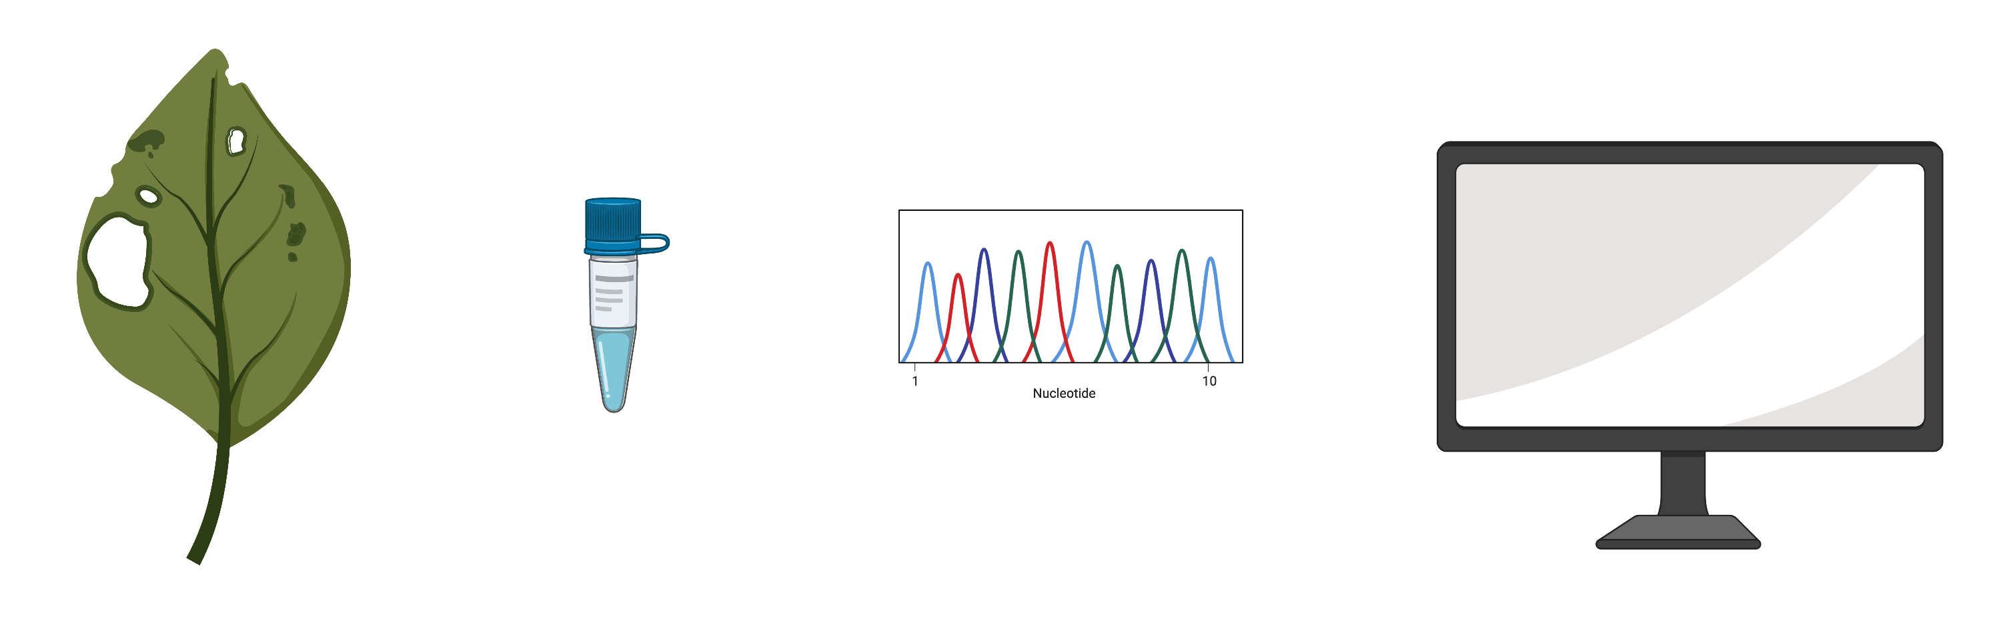
Science Fiction of Plant pathogen identification
The pathogen is:
Extract + sequence + computer programs + databases + AI + network
Fast: hours
Precise identification + characterization + outbreak investigation
for any and all pathogens
made with biorender.com
Notes:
Viruses, bacteria, fungi, oomycetes, established, emerging; characterization (phenotype prediction: host range, antibiotic/fungicide resistance …)

Slide 3
Pathogen Identification
Usually a two-step process:
Taxonomic identification to the genus or species rank
Strain typing to identify the precise strain within the species, source attribution, outbreak detection and investigation, …

Slide 4
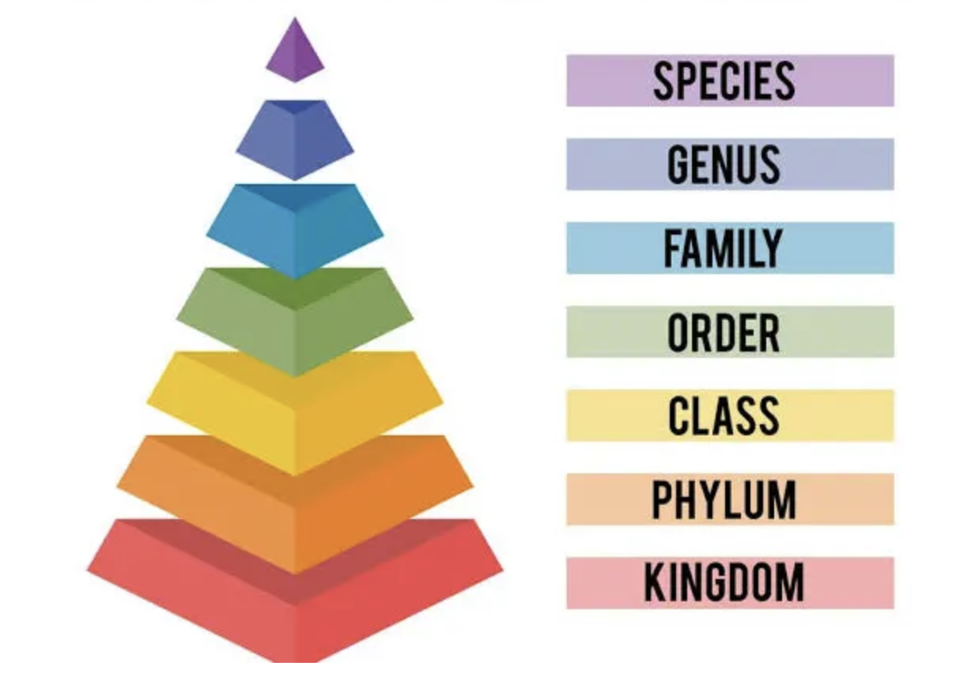
Taxonomy: identify to genus or species rank

Slide 5
Genome-based taxonomic identification (focus on prokaryotes)

Slide 6
Average Nucleotide Identity (ANI)
How different two genomes are from each other
Species delineation: 95%
Average amino acid identity (AAI) for higher taxonomic ranks
Genus 1 species 2
Genus 1 species 1
>95% ANI and share at least one diagnostic phenotype
type strain 2
<95% ANI
and different
in at least one
diagnostic phenotype
type strain 1

Slide 7
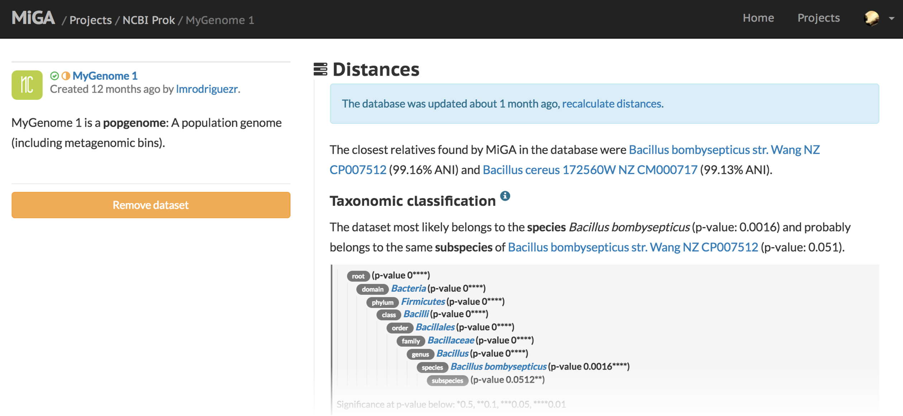

Rank-based taxonomy using genomics
Rodríguez-Rojas et al. 2018

Slide 8
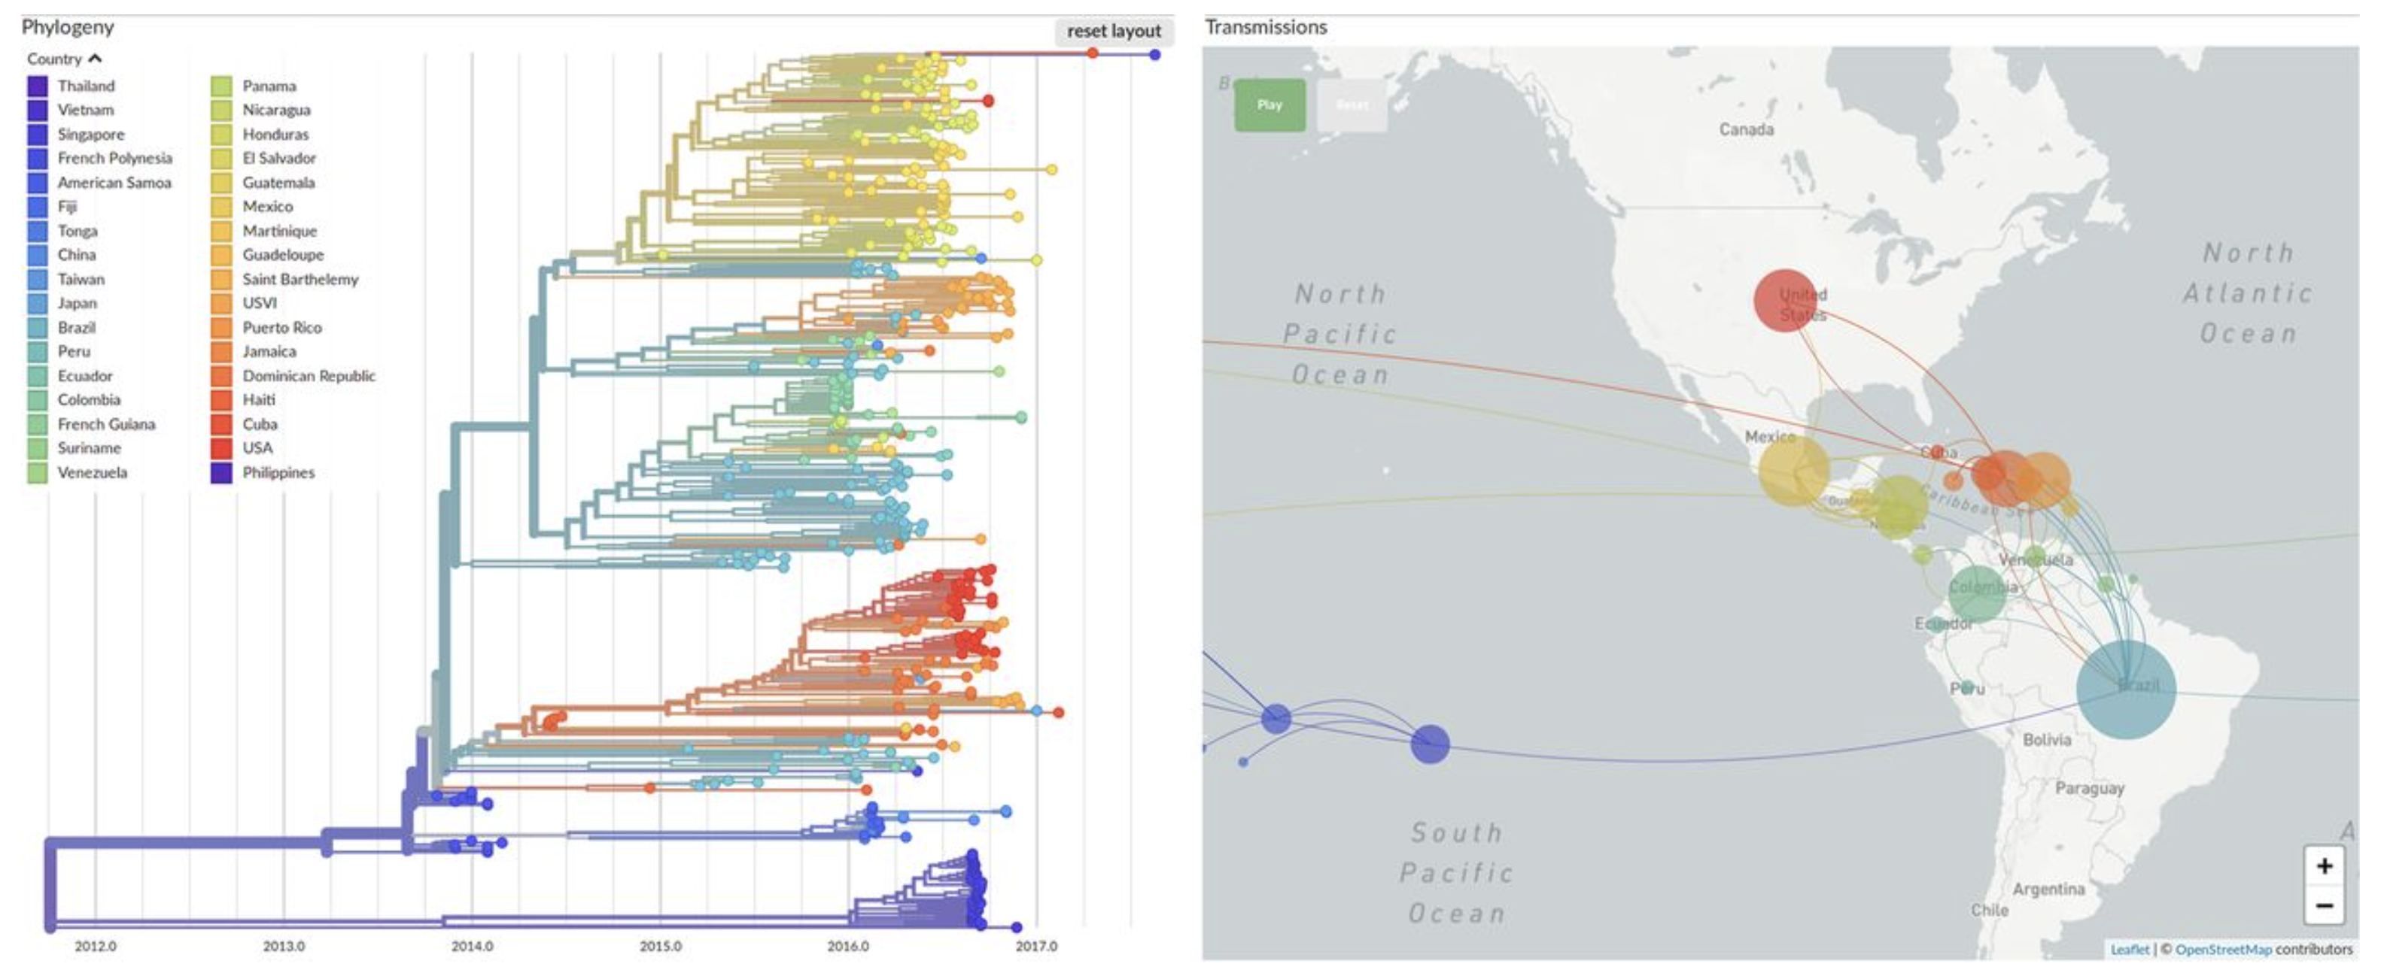
Strain-typing using genomics
Neher & Bedford 2018
Nextstrain, GenomeTrakr Network … needs to be set up new for each species

Slide 9
Bridging taxonomy and strain typing
Could we extend the use of ANI from the species rank towards the strain level … and detect outbreaks?
Yes, using the Life Identification Number (LIN) approach

Slide 10
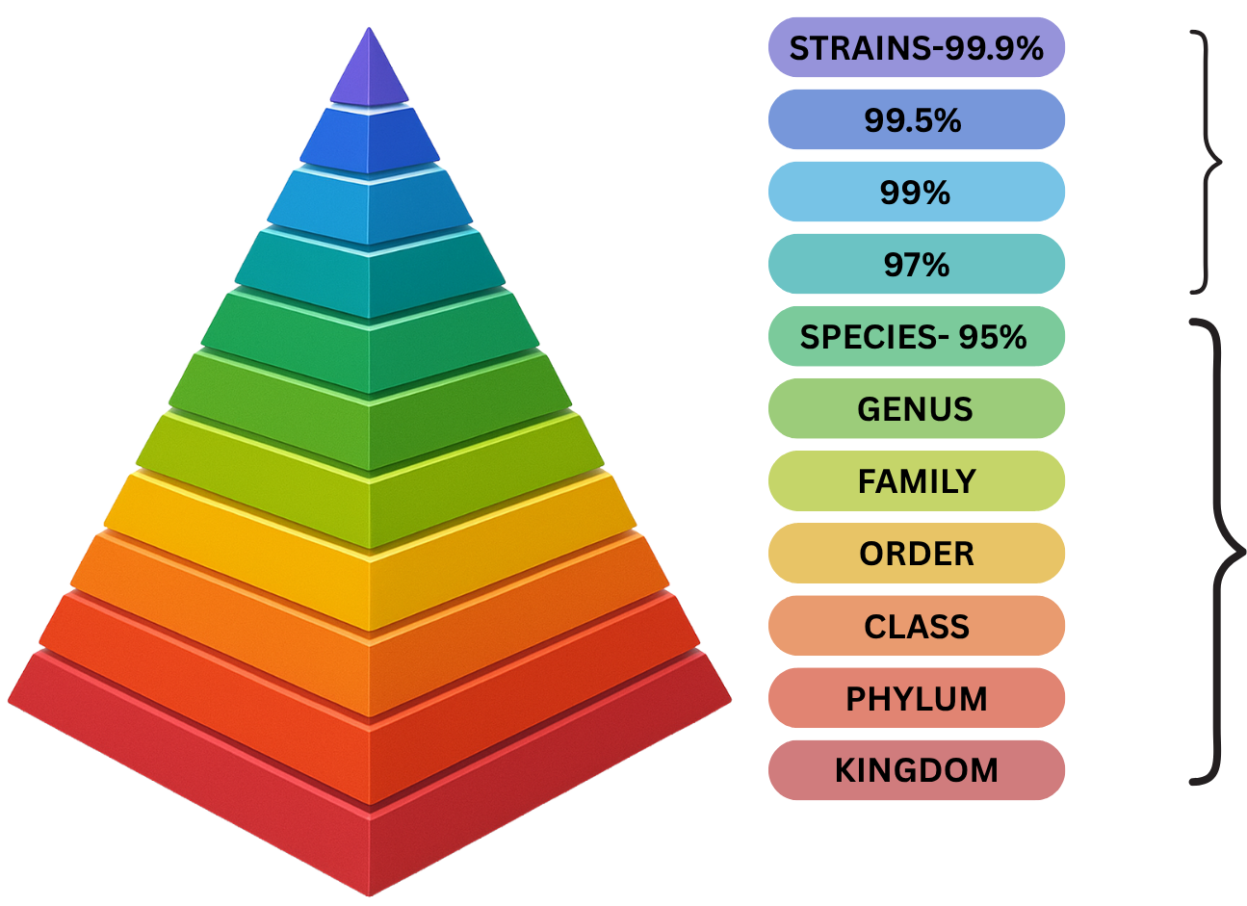
“Enhanced” taxonomy
(LINs)
Traditional taxonomy

Slide 11
Taxonomic Rank-Independent Taxonomy (simplified example)
genus
strain
ANI
LINs
* Type strain
Vinatzer et al 2017
ANI is informative from the genus rank and almost reaches strain-level resolution.

Slide 12
Taxonomic Rank-Independent Taxonomy (simplified example)
genus
strain
ANI
LINs
* Type strain
Vinatzer et al 2017
ANI is informative from the genus rank and almost reaches strain-level resolution.

Slide 13
Taxonomic Rank-Independent Taxonomy (simplified example)
genus
strain
ANI
LINs
* Type strain
Vinatzer et al 2017
ANI is informative from the genus rank and almost reaches strain-level resolution.

Slide 14
Real example: Ralstonia solanacearum species complex bacterial wilt species, phylotypes, sequevars …

Slide 15
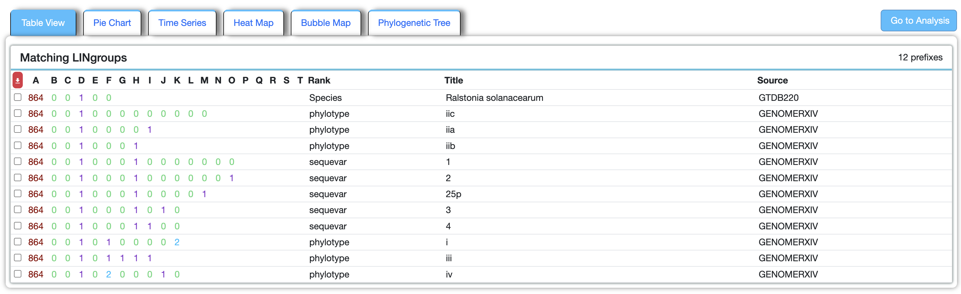
Select Agent
Extending ANI from the species to the strain:
Any monophyletic group can be circumscribed
Any genome can be identified as member of any circumscribed group

Slide 16
“Enhanced” taxonomy
(LINs)
Traditional taxonomy

